Slide 1
Practical Big Data Workshop 2018 Pre-meeting Hackathon
Johan van Soest, Andre Dekker, Zhenwei Shi
Department of Radiation Oncology (MAASTRO)
GROW - Maastricht University Medical Centre +
Maastricht, The Netherlands

Slide 2
Introductions, Practicalities, Setting-up 08:30
Johan van Soest, Andre Dekker, Zhenwei Shi
Department of Radiation Oncology (MAASTRO)
GROW - Maastricht University Medical Centre +
Maastricht, The Netherlands

Slide 3
Welcome!!
Introduce yourself
Name
Institution
Why you are here
Specific goals/datasets?

Slide 4
Overall Schedule
0830-1200 Morning Session
1200-1300 Lunch
1300-1500 Afternoon Session 1
1500-1515 Break
1515-1700 Afternoon Session 2
1800 meet at the watering hole HopCat
Note: We might end early but not late!

Slide 5
Morning plan
08:00 – 08:30 Breakfast and Registration
08:30 – 09:00 Introductions, Practicalities, Setting-up (Andre)
09:00 – 09:15 Hackathon goals (Johan)
09:15 – 09:45 Components - 1
Docker (Johan)
O-Raw (Zhenwei)
09:45 – 10:45 Hackathon: Radiomics
10:45 – 11:00 Components - 2
Semantic Web, RDF & Ontologies (Andre)
11:00 – 12:00 Hackathon: Clinical data
12:00 – 13:00 Lunch

Slide 6
Afternoon plan
13:00 – 13:30 Component - 3
SPARQL (Andre)
13:30 – 14:30 Hackathon: SPARQL querying - Combining data querying for both radiomics & clinical data
14:30 – 15:00 Component - 4
Support Vector Machines, Distributed learning (Johan)
15:00 – 15:15 Break
15:15 – 16:30 Hackathon: Distributed Learning
16:30 – 17:00 Wrap-up & experiences from participants

Slide 7
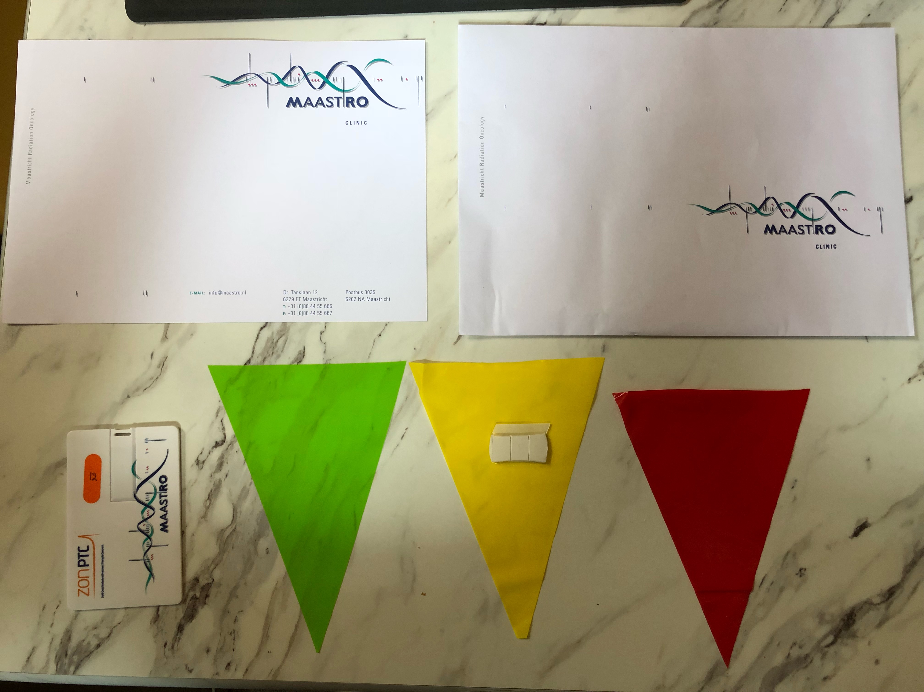
Practicalities
WiFi

Slide 8
Setting up, downloading, installing - 1
Hardware requirements
40GB of storage available
Moderately recent CPU (minimum i5 processor)
8 GB of RAM (not occupied by many other applications/services)
Operating System
Windows 10 (fall creators update or higher)
Windows Server 2012
macOS 10.13 (High Sierra)
Ubuntu 16.04, 17.10 or 18.04
In case of Windows 7, a virtual machine running Ubuntu 18.04, with 4-6 GB of RAM allocated would work as well.

Slide 9
Setting up, downloading, installing - 2
tinyurl.com/PBDW-Hackathon -> Step 0
Software
Docker
Python 2.7
Visual Studio Code (or another generic editor)
See the manual on the wiki!!

Slide 10
Flags please
Have you installed everything and can you run the following command in your terminal
docker run hello-world
This should give a response that every works, and is configured correctly.
Green: Yes
Yellow: Not yet but working on it
Red: Stuck please help
Nothing: Not playing

Slide 11
Hackathon goals 09:00
Johan van Soest, Andre Dekker, Zhenwei Shi
Department of Radiation Oncology (MAASTRO)
GROW - Maastricht University Medical Centre +
Maastricht, The Netherlands

Slide 12
Hackathon goals
Be as practical as we can!
Have fun
Extracting radiomics from real data
Mapping clinical variables to ontologies / Semantic Web
Putting Radiomics and Clinical together / SPARQL
Distributed analysis & learning
Final goal: Can we learn a predictive model jointly with all of you but without anyone seeing the others’ data??

Slide 13
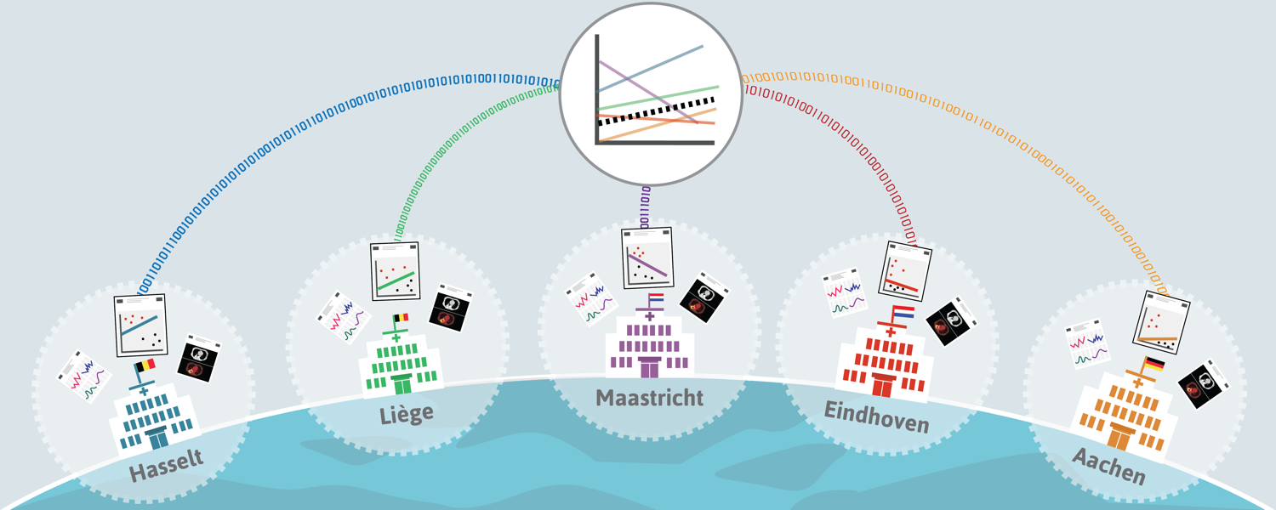
Sharing algorithms instead of data
Application of Machine Learning for Multicenter Learning, van Soest, Dekker, Roelofs, Nalbantov (2015)
Infrastructure and distributed learning methodology, Deist et al. (2017)

Slide 14
CORAL: Community in Oncology for RApid Learning
euroCAT
Lung
UK Aachen
LOC Hasselt
Catharina
MAASTRO
CHU Liege
meerCAT
Lung
U Michigan
MAASTRO
The Christie
7
sinoCAT / VATE / SAGE
Rectum
Fudan
Rome
RTOG/NRG
Starting
BCCA (Breast)
Bloemfontein (Cervix)
Odense (HN, Lung)
Aalst (Lung)
McGill (Brain)
canCAT
Sarcoma
MGH
MAASTRO
BIONIC
Radiomics
MAASTRO
Tata
ozCAT
Head&Neck, Lung
Liverpool
Illawarra
Newcastle
Westmead
MAASTRO
RTOG/NRG
duCAT
Lung, Breast
MAASTRO
Radboud
NKI
Erasmus
UMCU
ukCAT
Lung, Anal, Esophagus
Cardiff
Christie
Leeds
4
cuCAT
Esophagus
Cardiff
MAASTRO
canCAT
Lung
Princess Margaret
MAASTRO
Map © Copyright Showeet.com

Slide 15
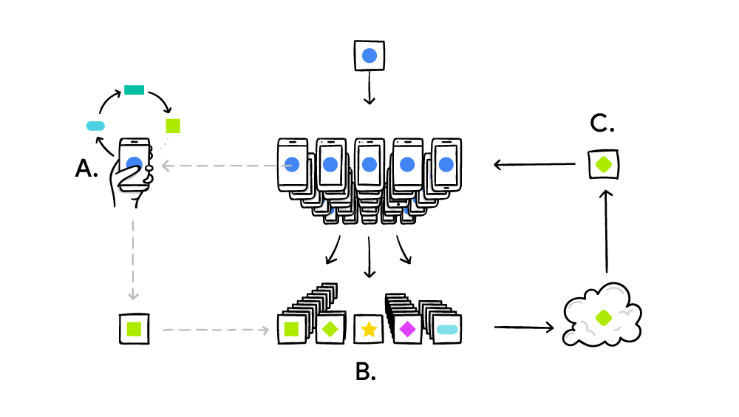
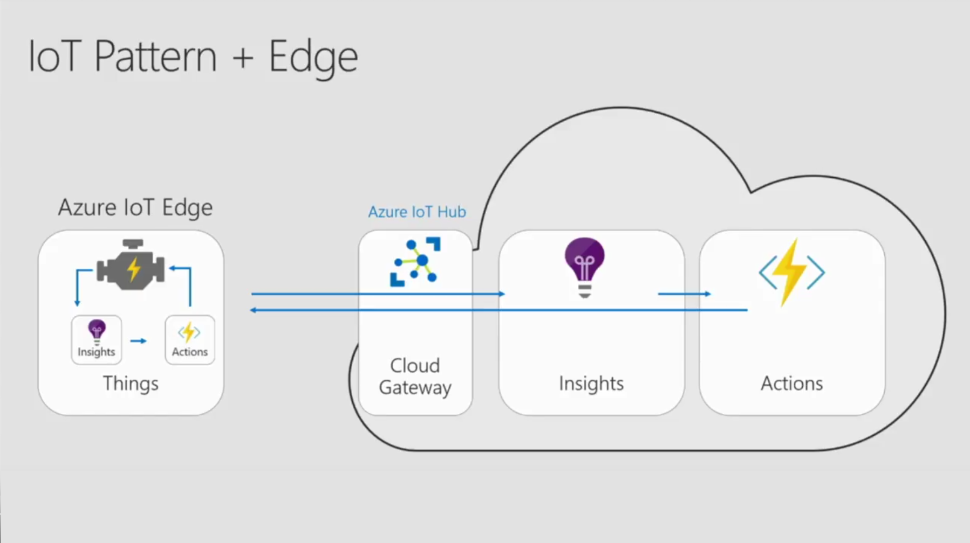
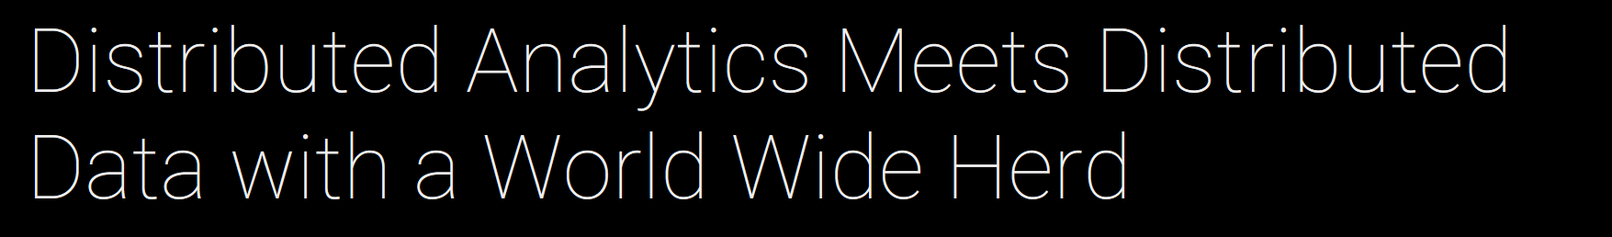

Is it new?
Your phone personalizes the model locally, based on your usage (A).Many users' updates are aggregated (B) to form
a consensus change (C) to the shared model, after which the procedure is repeated. (Google 2017)
Azure IoT Edge moves cloud analytics and business logic to devices

Slide 16
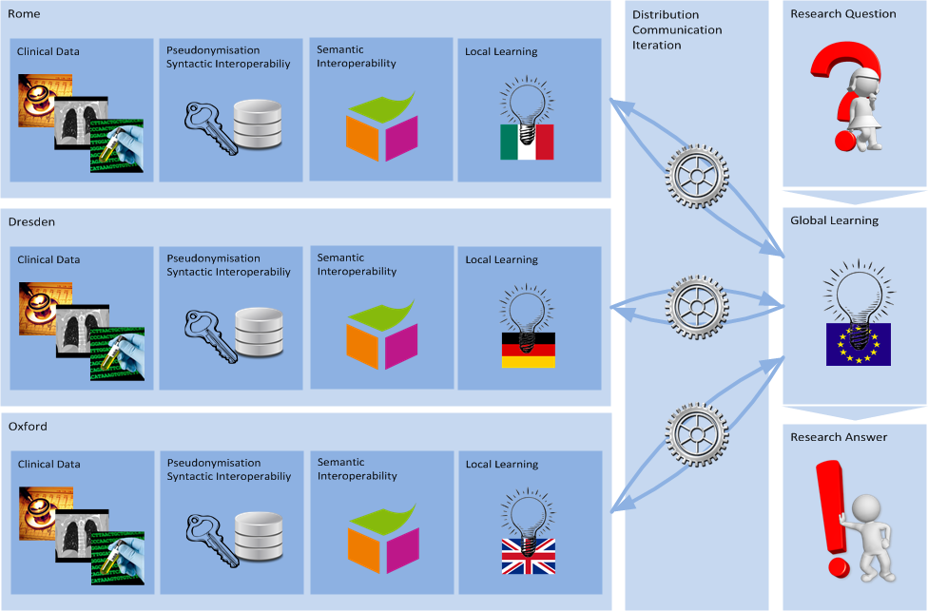
Generic infrastructure overview

Slide 17
Detailed steps - Hackathon
Step 2: Importing DICOM & Radiomics
Step 3: Importing clinical data
Step 4: SPARQL
Step 5: Distributed learning / PHT station

Slide 18
Docker Component 09:15
Johan van Soest, Andre Dekker, Zhenwei Shi
Department of Radiation Oncology (MAASTRO)
GROW - Maastricht University Medical Centre +
Maastricht, The Netherlands

Slide 19
Based on Docker

Slide 20
Docker containers & images?
Image:
Template of container
Can be pushed/pulled registry
Container:
Running instance of image
Can contain data specific for this instance
“spawn” new instance from image

Slide 21
Small exercise
Run the following command:
docker run hello-world
https://github.com/jvsoest/PBDW2018_hackathon

Slide 22
Docker containers (multiple)
Link multiple containers together (in separate network)
Postgres
R2RML
RDF endpoint
(GraphDB)
Jupyter notebook
O-RAW

Slide 23
O-RAW 09:30
Johan van Soest, Andre Dekker, Zhenwei Shi
Department of Radiation Oncology (MAASTRO)
GROW - Maastricht University Medical Centre +
Maastricht, The Netherlands

Slide 24

Radiomics is an emerging field that converts imaging data into a high dimensional mineable feature space using a large number of automatically extracted data-characterization algorithms [1].
[1] Aerts, Hugo JWL, et al. "Decoding tumour phenotype by noninvasive imaging using a quantitative radiomics approach." Nature communications 5 (2014): 4006.

Slide 25
Challenges
Lack of standardized methodology
Lack of universal lexicon of radiomic features
Flat table - Insufficient details on feature extraction

Slide 26
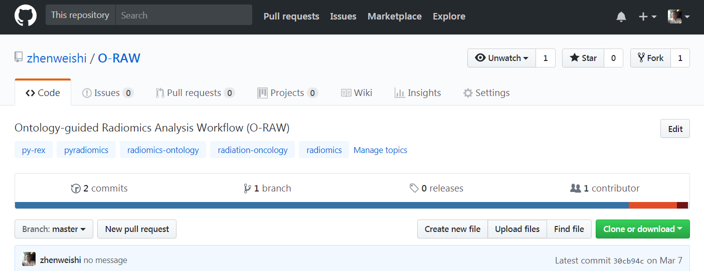
O-RAW ^{[1]}
open-source software package
a standard lexicon to uniquely describe features in common usage
methods to publish radiomic features as a semantically-interoperable data graph object
[1] O-RAW Github: https://github.com/zhenweishi/O-RAW

Slide 27
Two components
PyRadomics
Py-rex (PyRadiomic extension)

Slide 28
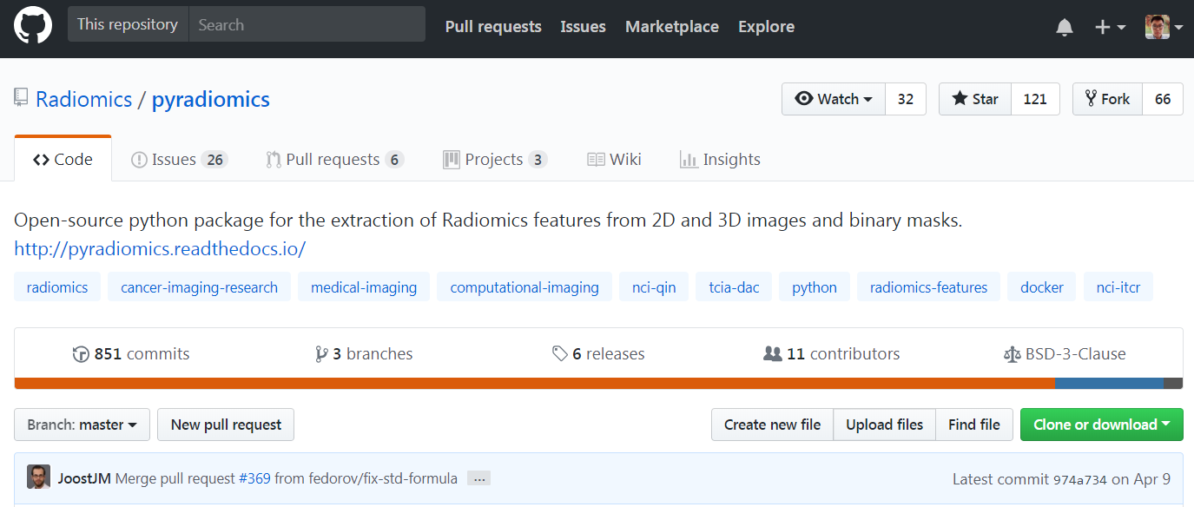
Two components
PyRadomics ^{[1,2,3]} :Radiomics extractor
Pyrex (PyRadiomics extension)
[1] PyRadiomics Github: https://github.com/Radiomics/pyradiomics
[2] PyRadiomics Docs: http://pyradiomics.readthedocs.io
[3] PyRadiomics publication: van Griethuysen, Joost JM, et al. "Computational Radiomics System to Decode the Radiographic Phenotype." Cancer research 77.21 (2017): e104-e107.

Slide 29
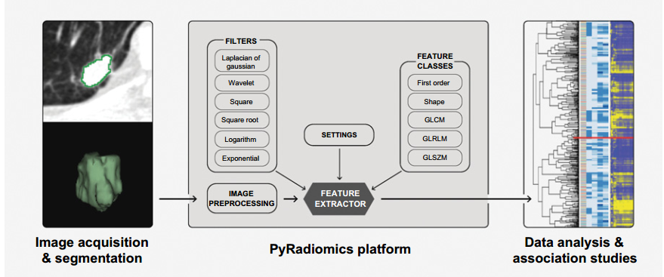
PyRadiomics
Not support for DICOM-RT as input
! ! !
Image and binary mask
Enabled filters
Calculation of feature
Results
Joost JM, et al. "Computational Radiomics System to Decode the Radiographic Phenotype." Cancer research 77.21 (2017): e104-e107.
Notes:
Loading and preprocessing of image and segmentation maps
Application of enabled filters
Calculation of feature using different feature classes
Returning results

Slide 30
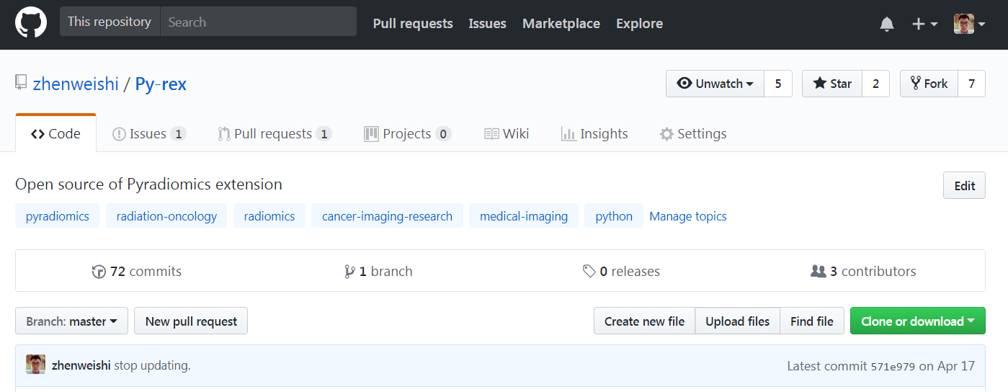
Two components
PyRadomics:Radiomics extractor
Py-rex ^{[1]} (pyradiomics extension)
[1] Py-rex Github: https://github.com/zhenweishi/Py-rex

Slide 31
Py-rex
a set of modules
DICOM-RT reader
Binary mask generation
RDF conversion
. . .
DICOM-RT
PyRadiomics
RDF triple store
Py-rex
Py-rex
Notes:
Py-rex can extend pyradiomics on both input and output sides.

Slide 32

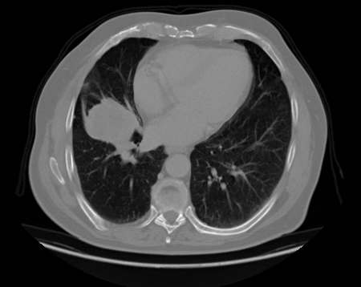
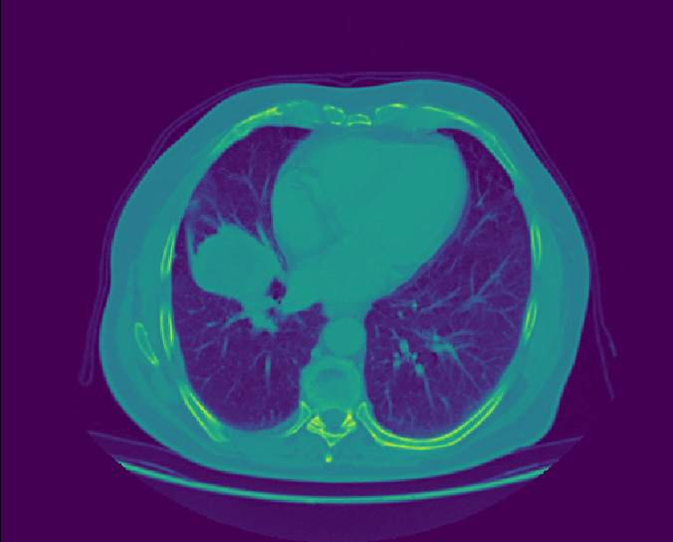
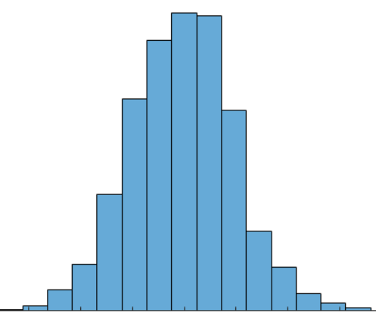
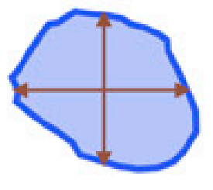

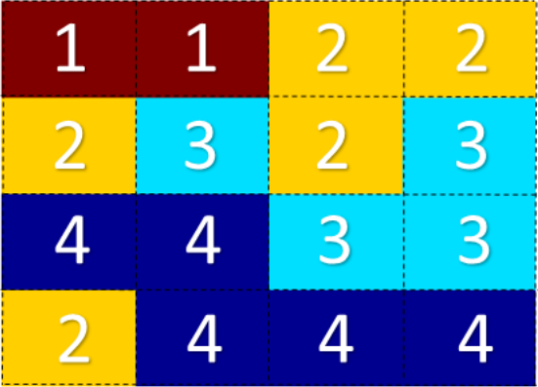
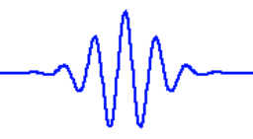

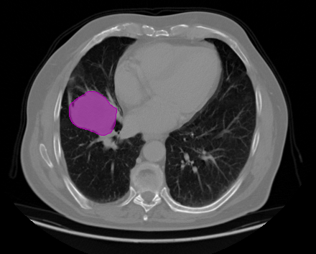
Four main steps in O-RAW
Step-4: Py-rex parses radiomics results as a W3C-compliant semantic web triple store with metalables Radiation Oncology Ontology and Radiomics Ontology.
Step-1: scans and RTSTRUCT matching.
Imaging
Imaging
Radiomics
Intensity
Shape
Segmentation
Binary Mask
Texture
Wavelet
DICOM-RT
Array of voxel
Feature extraction
RDF triple store
Step-3: PyRadiomics perfroms feature extraction.
Step-2: Py-rex takes DICOM-RT and parse them as
array of voxel intensities and binary mask for each ROI.

Slide 33
Step-1
DICOM image and RTSTRUCT searching Strategy
SOP instance UID
RTRSTRUCT-1
Temporal directory
By patient ID
Image_Dir
scan-1
scan-2
Copy dicom files to tmp folder
Patient-1
scan-3
scan-4
Py-rex
…
RTSTRUCT_Dir
CT Series Instance UID
…
RTRSTRUCT-2
Patient-N
…
Notes:
In RTSTRUCT, Referenced frame of Reference sequence -> RT referenced study sequence -> RT referenced series sequence -> Series instance UID = Series instance UID in CT.

Slide 34
Step-2
Imaging
3d image array
Loaded by pydicom
PyRadiomics
Pyrex
Segmentation
3d mask zero-array
DICOM-RTSTRUCT
SimpleITK object
Notes:
Py-rex takes native DICOM series and RTSTRUCT
Py-rex loads DICOM-RT through pydicom.
CT slices are sorted coordinate of z-axis -> 3d Image
Py-rex generates a zero-arrary with the same size of Image.
For each ROI, set voxel to “1” inside the ROI and voxel to “0” outside the ROI -> 3d Mask.
Image and Mask are both SimpleITK objects, which can be fed to pyradiomics.

Slide 35
Step-3
PyRadiomics performs feature extraction
Pre-processing methods (e.g., resampling and cropping) using SimpleITK.
Radiomic features consist of first order statistics, shape-based, texture and filters.

Slide 36
Step-4
Py-rex converts radiomic features (python dictionary object) to RDF (default)
Patient
Has_pacs_scan
SCAN
Converted_to
Image_Volume
Is_part_of
Image_Space
Has
Local_name
Link by patient_ID
Clinical data
Used_to_compute
Radiomic features
Has_value
Has_unit
value
unit
…
Notes:
Aside from calculating features, the pyradiomics package includes provenance information in the output. This information contains information on used image and mask, as well as applied settings and filters, thereby enabling fully reproducible feature extraction

Slide 37
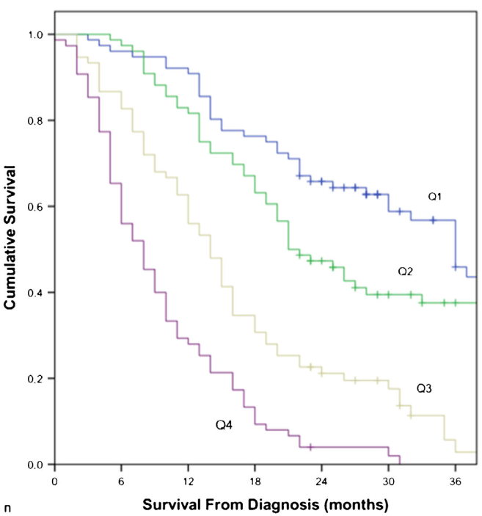
Imaging Data
O-RAW
Modelling
Imaging
Imaging
Radiomics
Intensity
Shape
Segmentation
Binary Mask
Texture
Wavelet
DICOM-RT
Array of voxel
Feature extraction
RDF triple store

Slide 38
Hackathon – Radiomics 09:45
Johan van Soest, Andre Dekker, Zhenwei Shi
Department of Radiation Oncology (MAASTRO)
GROW - Maastricht University Medical Centre +
Maastricht, The Netherlands

Slide 39
Semantic Web 10:45
Johan van Soest, Andre Dekker, Zhenwei Shi
Department of Radiation Oncology (MAASTRO)
GROW - Maastricht University Medical Centre +
Maastricht, The Netherlands

Slide 40
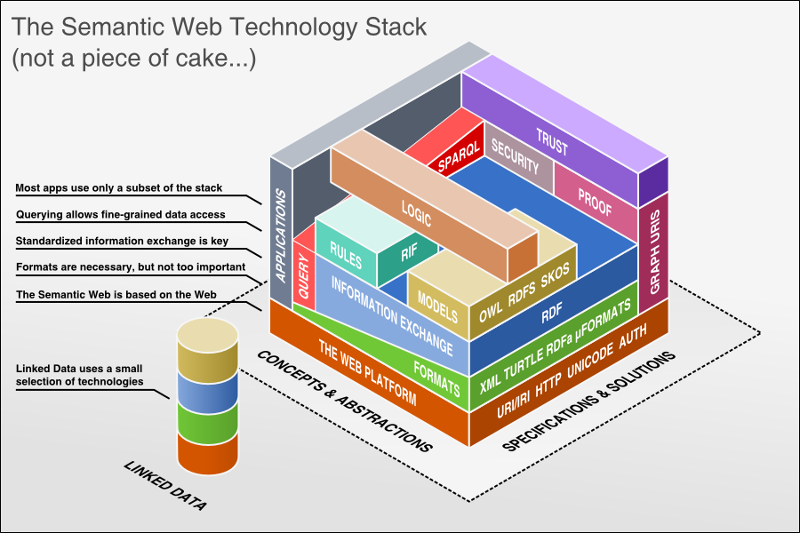
Semantic Web
http://bnode.org/blog/2009/07/08/the-semantic-web-not-a-piece-of-cake

Slide 41

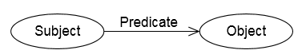
RDF: Resource Description Framework
Triple: Subject – Predicate – Object
RDF, triple, statement
Andre – works_at – MAASTRO
<http://www.pbdw.com#Andre> <http://www.pbdw.com#works_at> ”MAASTRO"^^xsd:string .
@prefix pbdw: <http://www.pbdw.com#>
pbdw:Andre pbdw:works_at ”MAASTRO"^^xsd:string .
Graphs

Slide 42
RDF: Resource Description Framework
IRI and Literal
Andre – works_at – MAASTRO
<http://www.pbdw.com#Andre> <http://www.pbdw.com#works_at> ”MAASTRO"^^xsd:string .
Zhenwei – works_at – MAASTRO
<http://www.pbdw.com#Zhenwei> <http://www.pbdw.com#works_at> ”MAASTRO"^^xsd:string .
Better
<http://www.pbdw.com#Andre> <http://www.pbdw.com#works_at> <http://www.pbdw.com#MAASTRO> .
<http://www.pbdw.com#Zhenwei> <http://www.pbdw.com#works_at> <http://www.pbdw.com#MAASTRO> .
Because then they are linked!

Slide 43
RDFS:RDF Schema
RDF Schema provides a data-modelling vocabulary for RDF data. RDF Schema is an extension of the basic RDF vocabulary.
Class
pbdw:MAASTRO a pbdw:CancerCenter
pbdw:PennRadiationOncology a pbdw:CancerCenter
pbdw:Andre pbdw:works_at pbdw:MAASTRO
pbdw:Ying pbdw:works_at pbdw:PennRadiationOncology
Then I can ask the question: Who is working at a CancerCenter and get Ying and Andre back.
subClassOf
pbdw:CancerCenter rdfs:subClassOf pbdw:CareOrganization
Then I can ask the question: Who is working at any subclass of a CareOrganization and get Ying and Andre back.
Labels
pbdw:Andre pbdw:works_at pbdw:12345
pbdw:12345 rdfs:label ”MAASTRO”

Slide 44
Radiation Oncology Ontology
Protégé

Slide 45
Visualization as a graph
LD-VOWL

Slide 46
Hackathon – Clinical Data 11:00
Johan van Soest, Andre Dekker, Zhenwei Shi
Department of Radiation Oncology (MAASTRO)
GROW - Maastricht University Medical Centre +
Maastricht, The Netherlands

Slide 47
Lunch 12:00
Johan van Soest, Andre Dekker, Zhenwei Shi
Department of Radiation Oncology (MAASTRO)
GROW - Maastricht University Medical Centre +
Maastricht, The Netherlands

Slide 48
SPARQL, Inference 13:00
Johan van Soest, Andre Dekker, Zhenwei Shi
Department of Radiation Oncology (MAASTRO)
GROW - Maastricht University Medical Centre +
Maastricht, The Netherlands

Slide 49
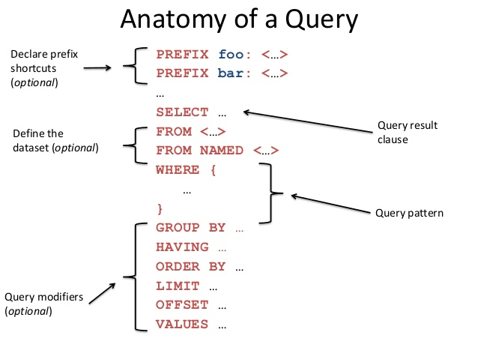
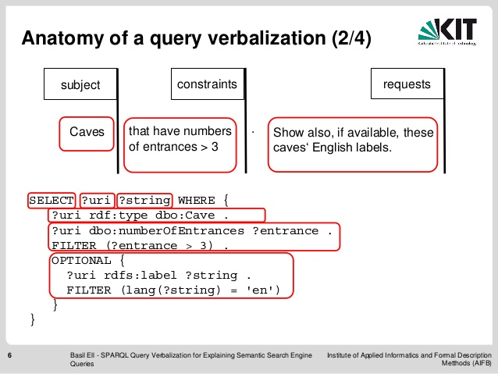
SPARQL Protocol and RDF Query Language
https://www.w3.org/TR/sparql11-overview/

Slide 50
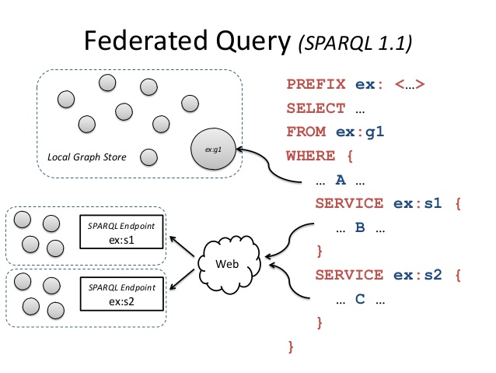
Federated SPARQL
https://www.w3.org/TR/sparql11-overview/

Slide 51
Support Vector Machines & Distributed Learning 14:30
Johan van Soest, Andre Dekker, Zhenwei Shi
Department of Radiation Oncology (MAASTRO)
GROW - Maastricht University Medical Centre +
Maastricht, The Netherlands

Slide 52
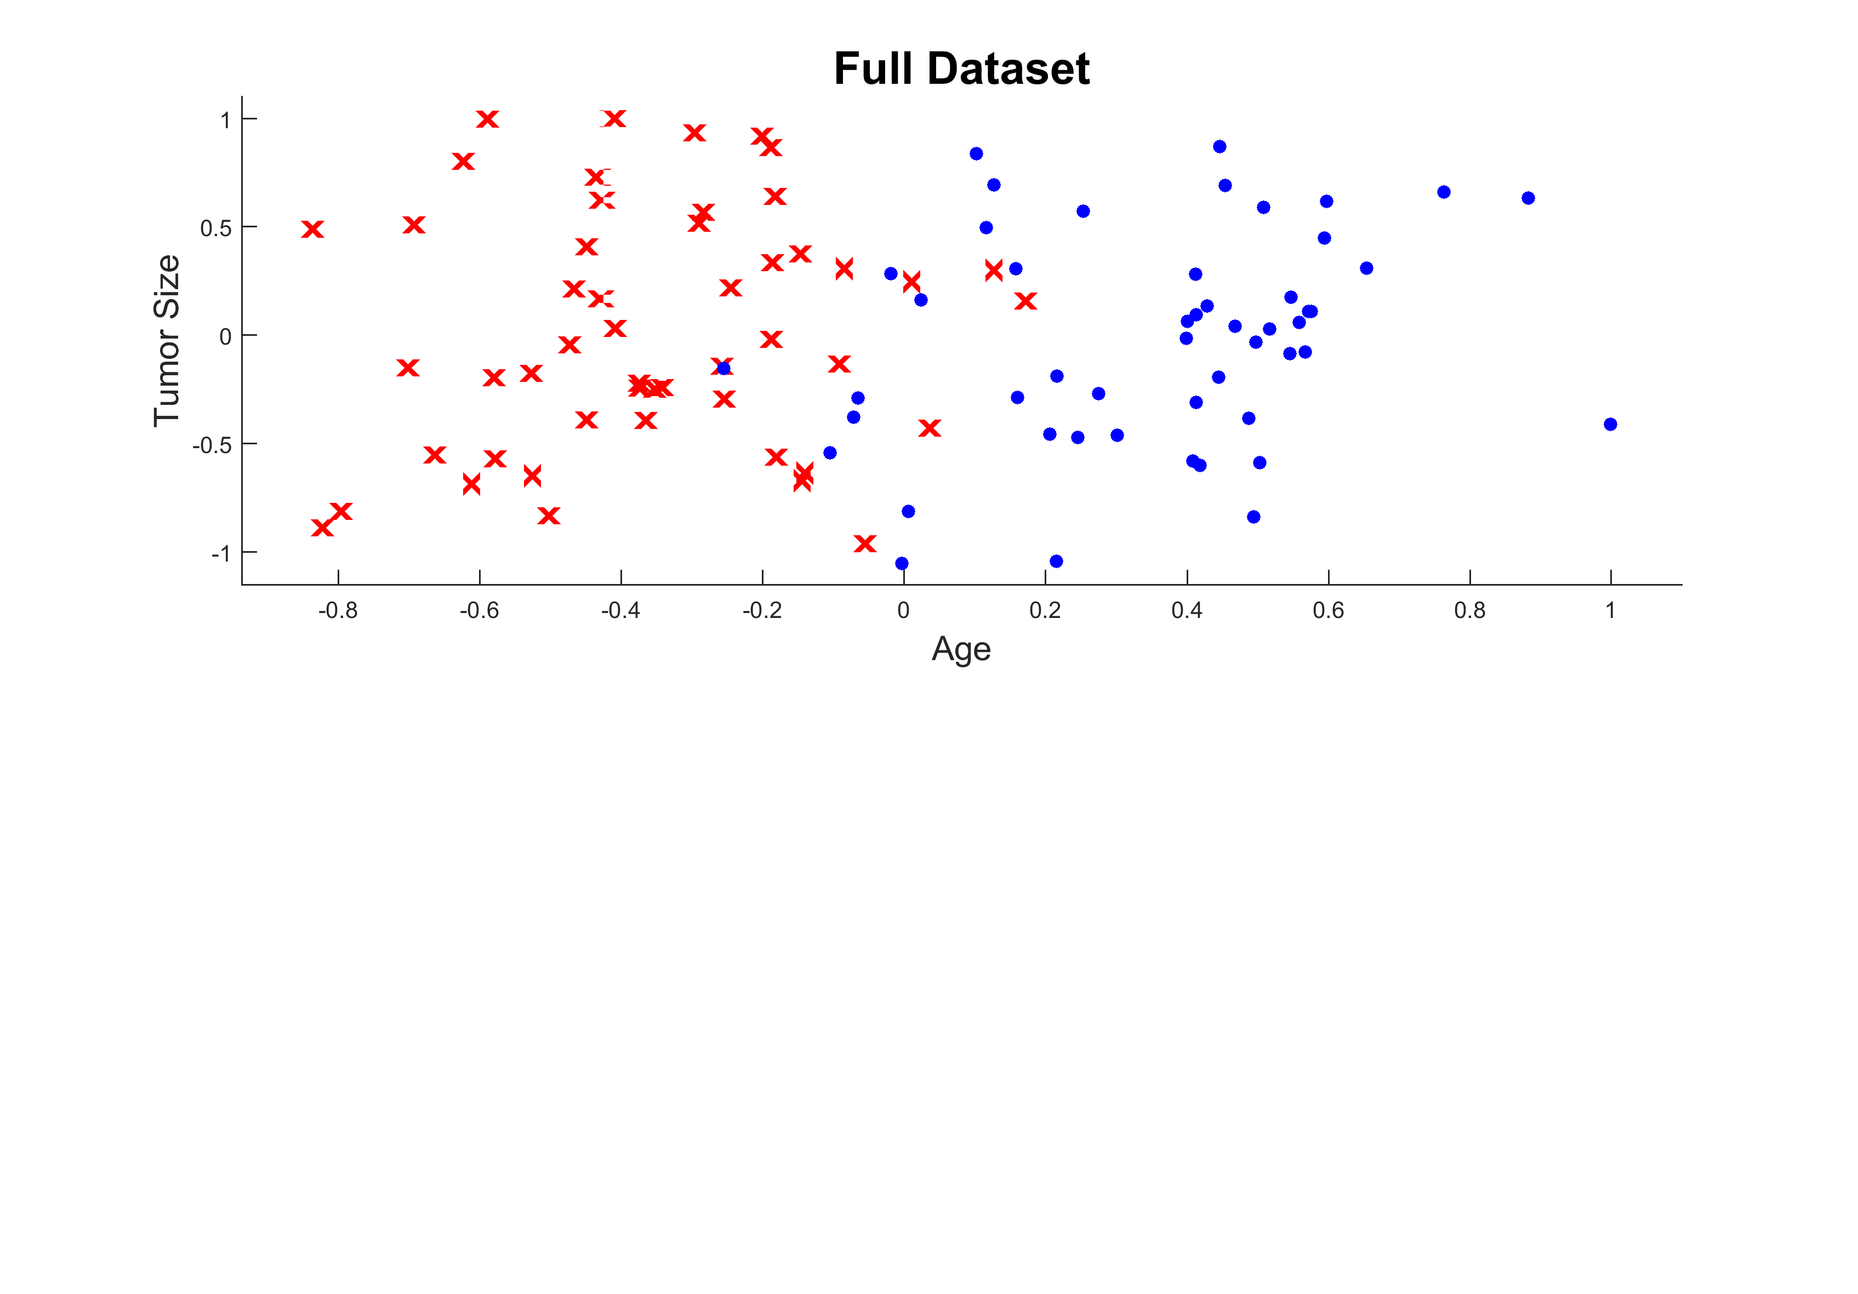
Event Patient
Non-Event Patient
Distributed Learning Solution
Centralized Learning Solution
Averaged Solution

Slide 53
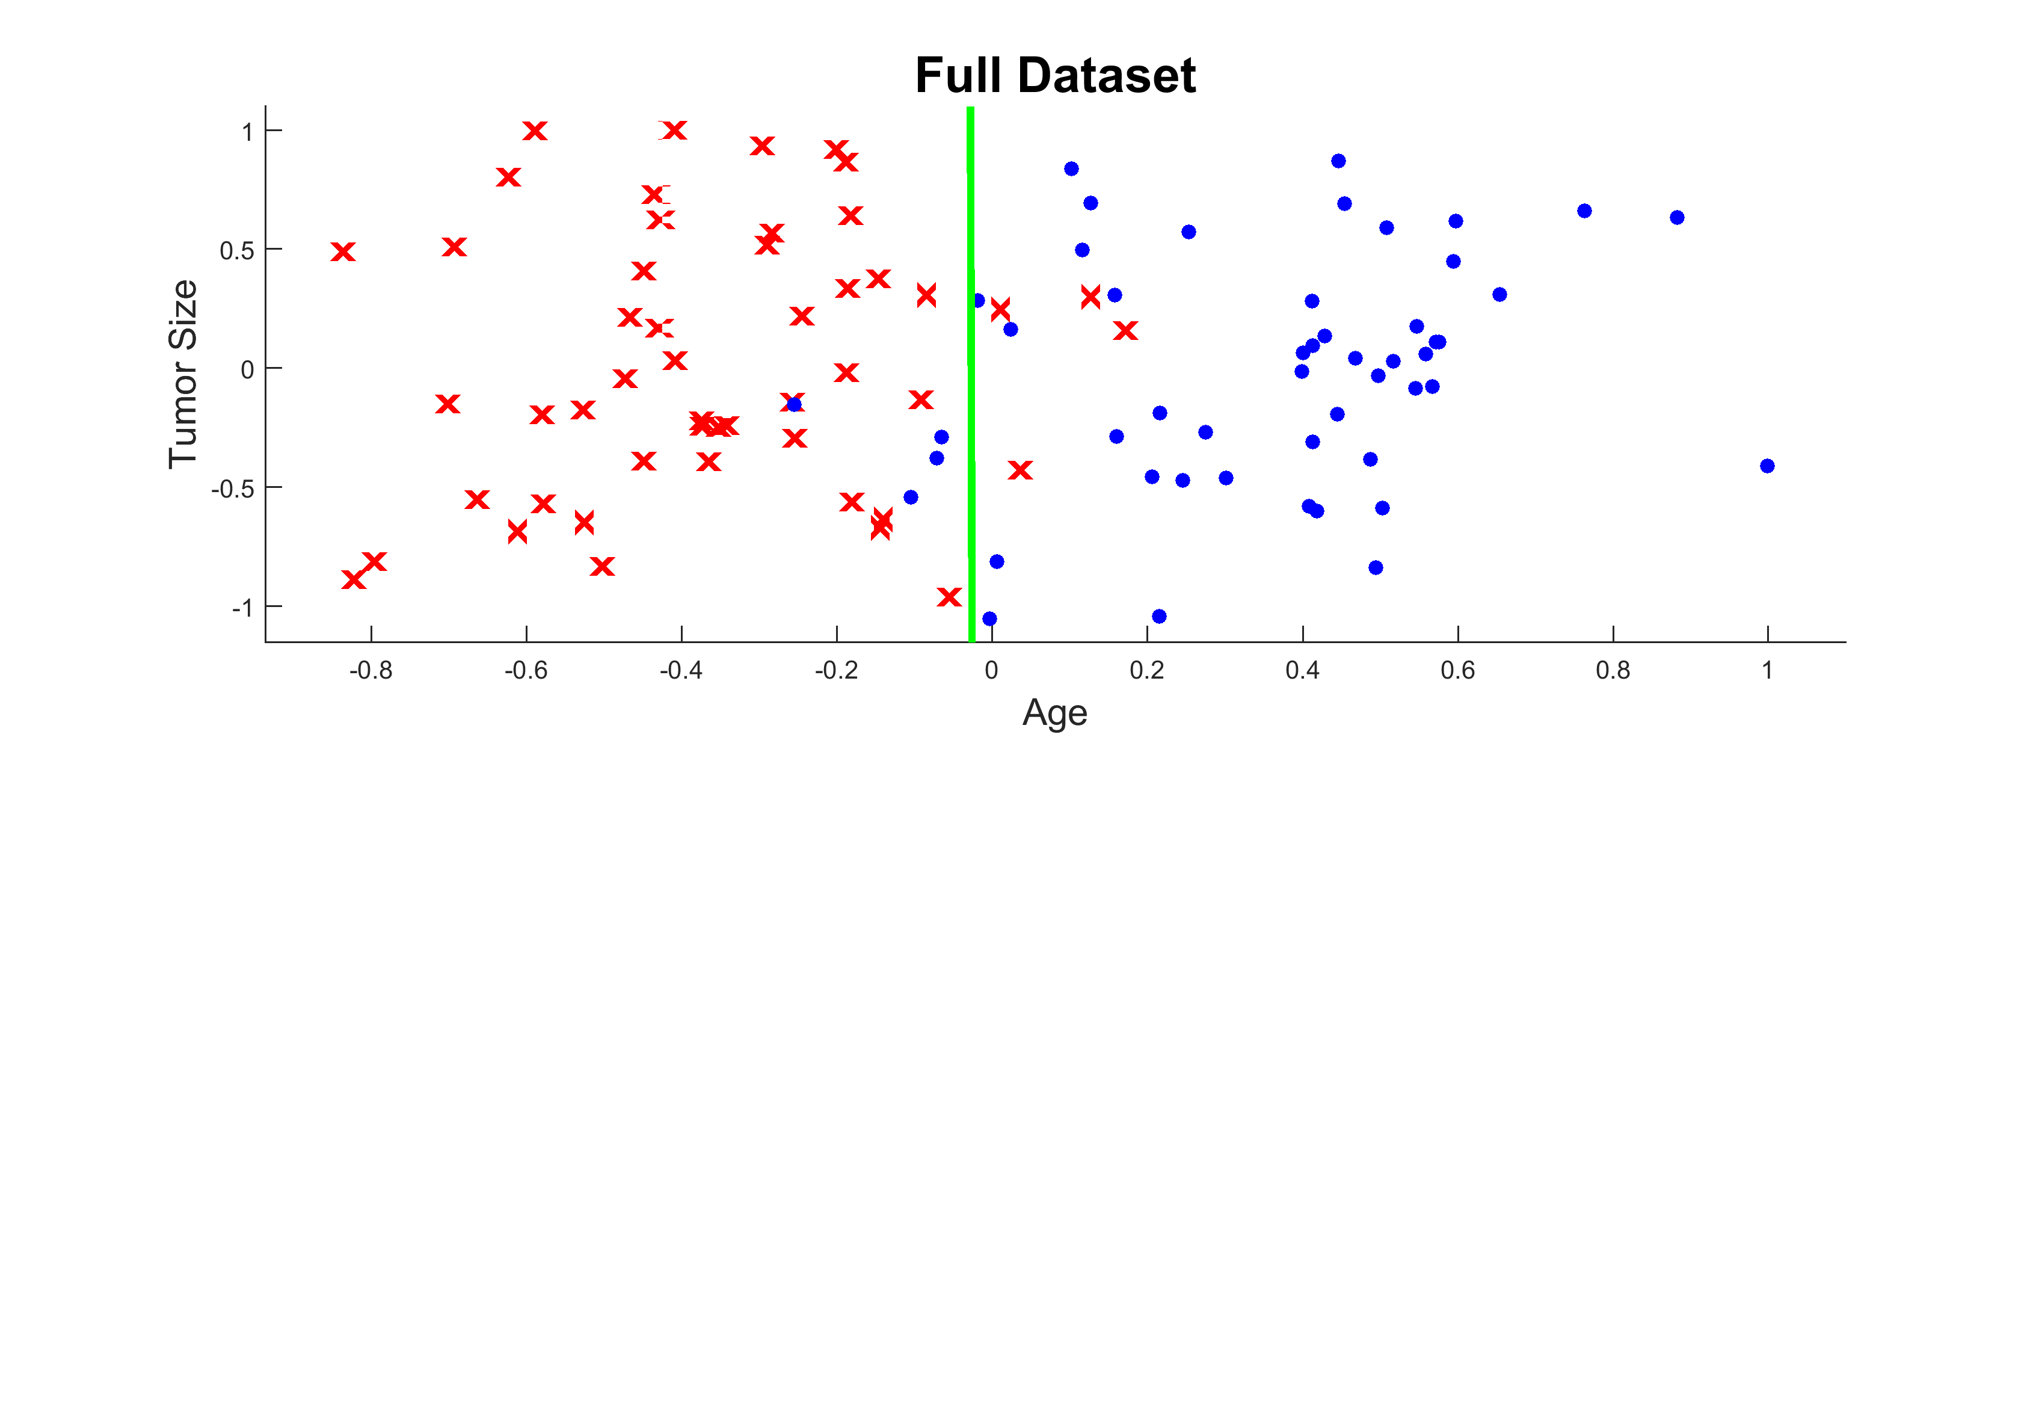
Event Patient
Non-Event Patient
Distributed Learning Solution
Centralized Learning Solution
Averaged Solution

Slide 54
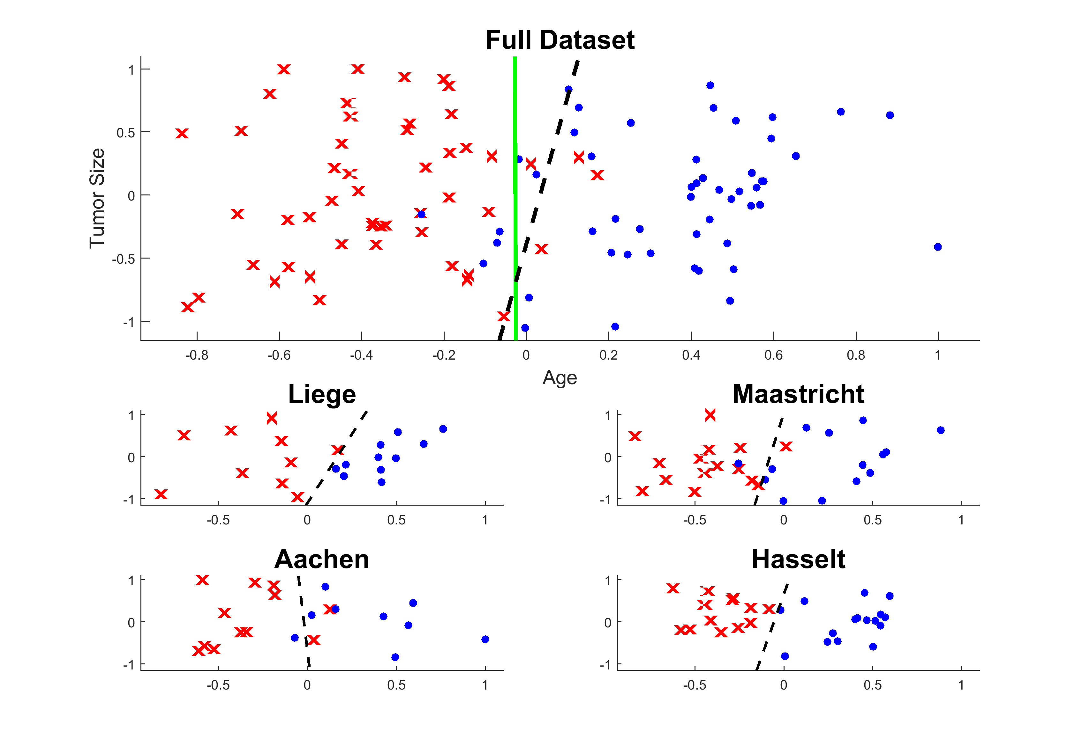
Event Patient
Non-Event Patient
Distributed Learning Solution
Centralized Learning Solution
Averaged Solution

Slide 55
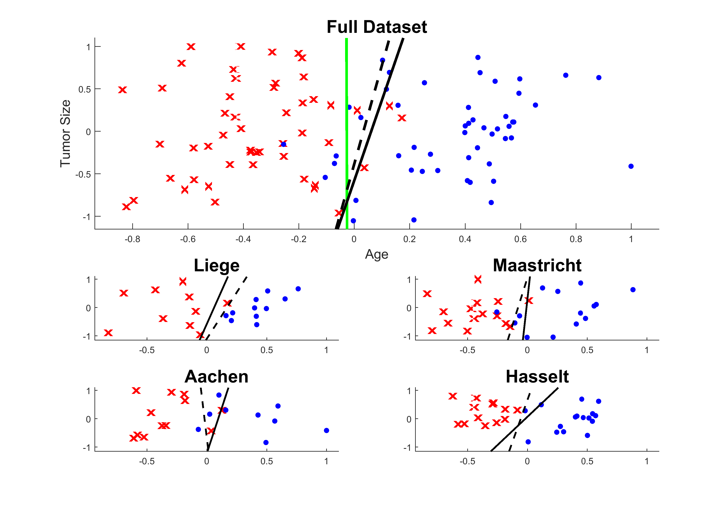
Event Patient
Non-Event Patient
Distributed Learning Solution
Centralized Learning Solution
Averaged Solution
Iteration
1

Slide 56
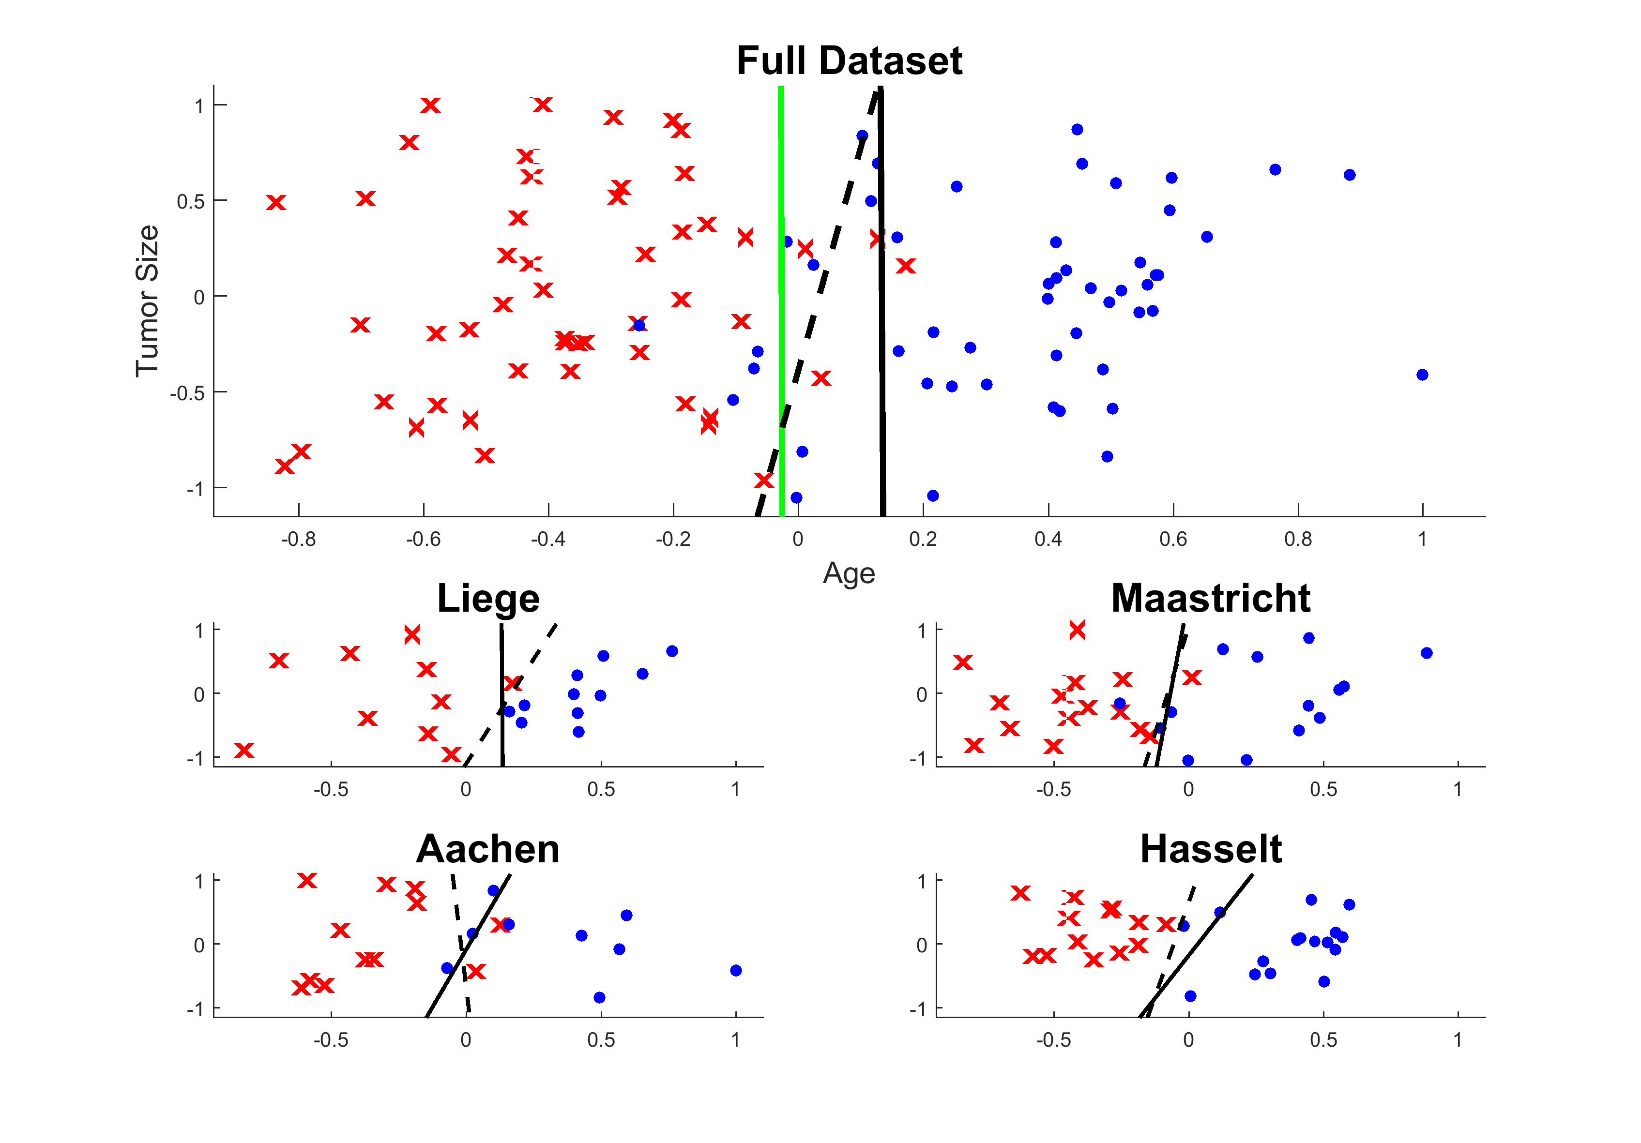
Event Patient
Non-Event Patient
Distributed Learning Solution
Centralized Learning Solution
Averaged Solution
Iteration
2

Slide 57
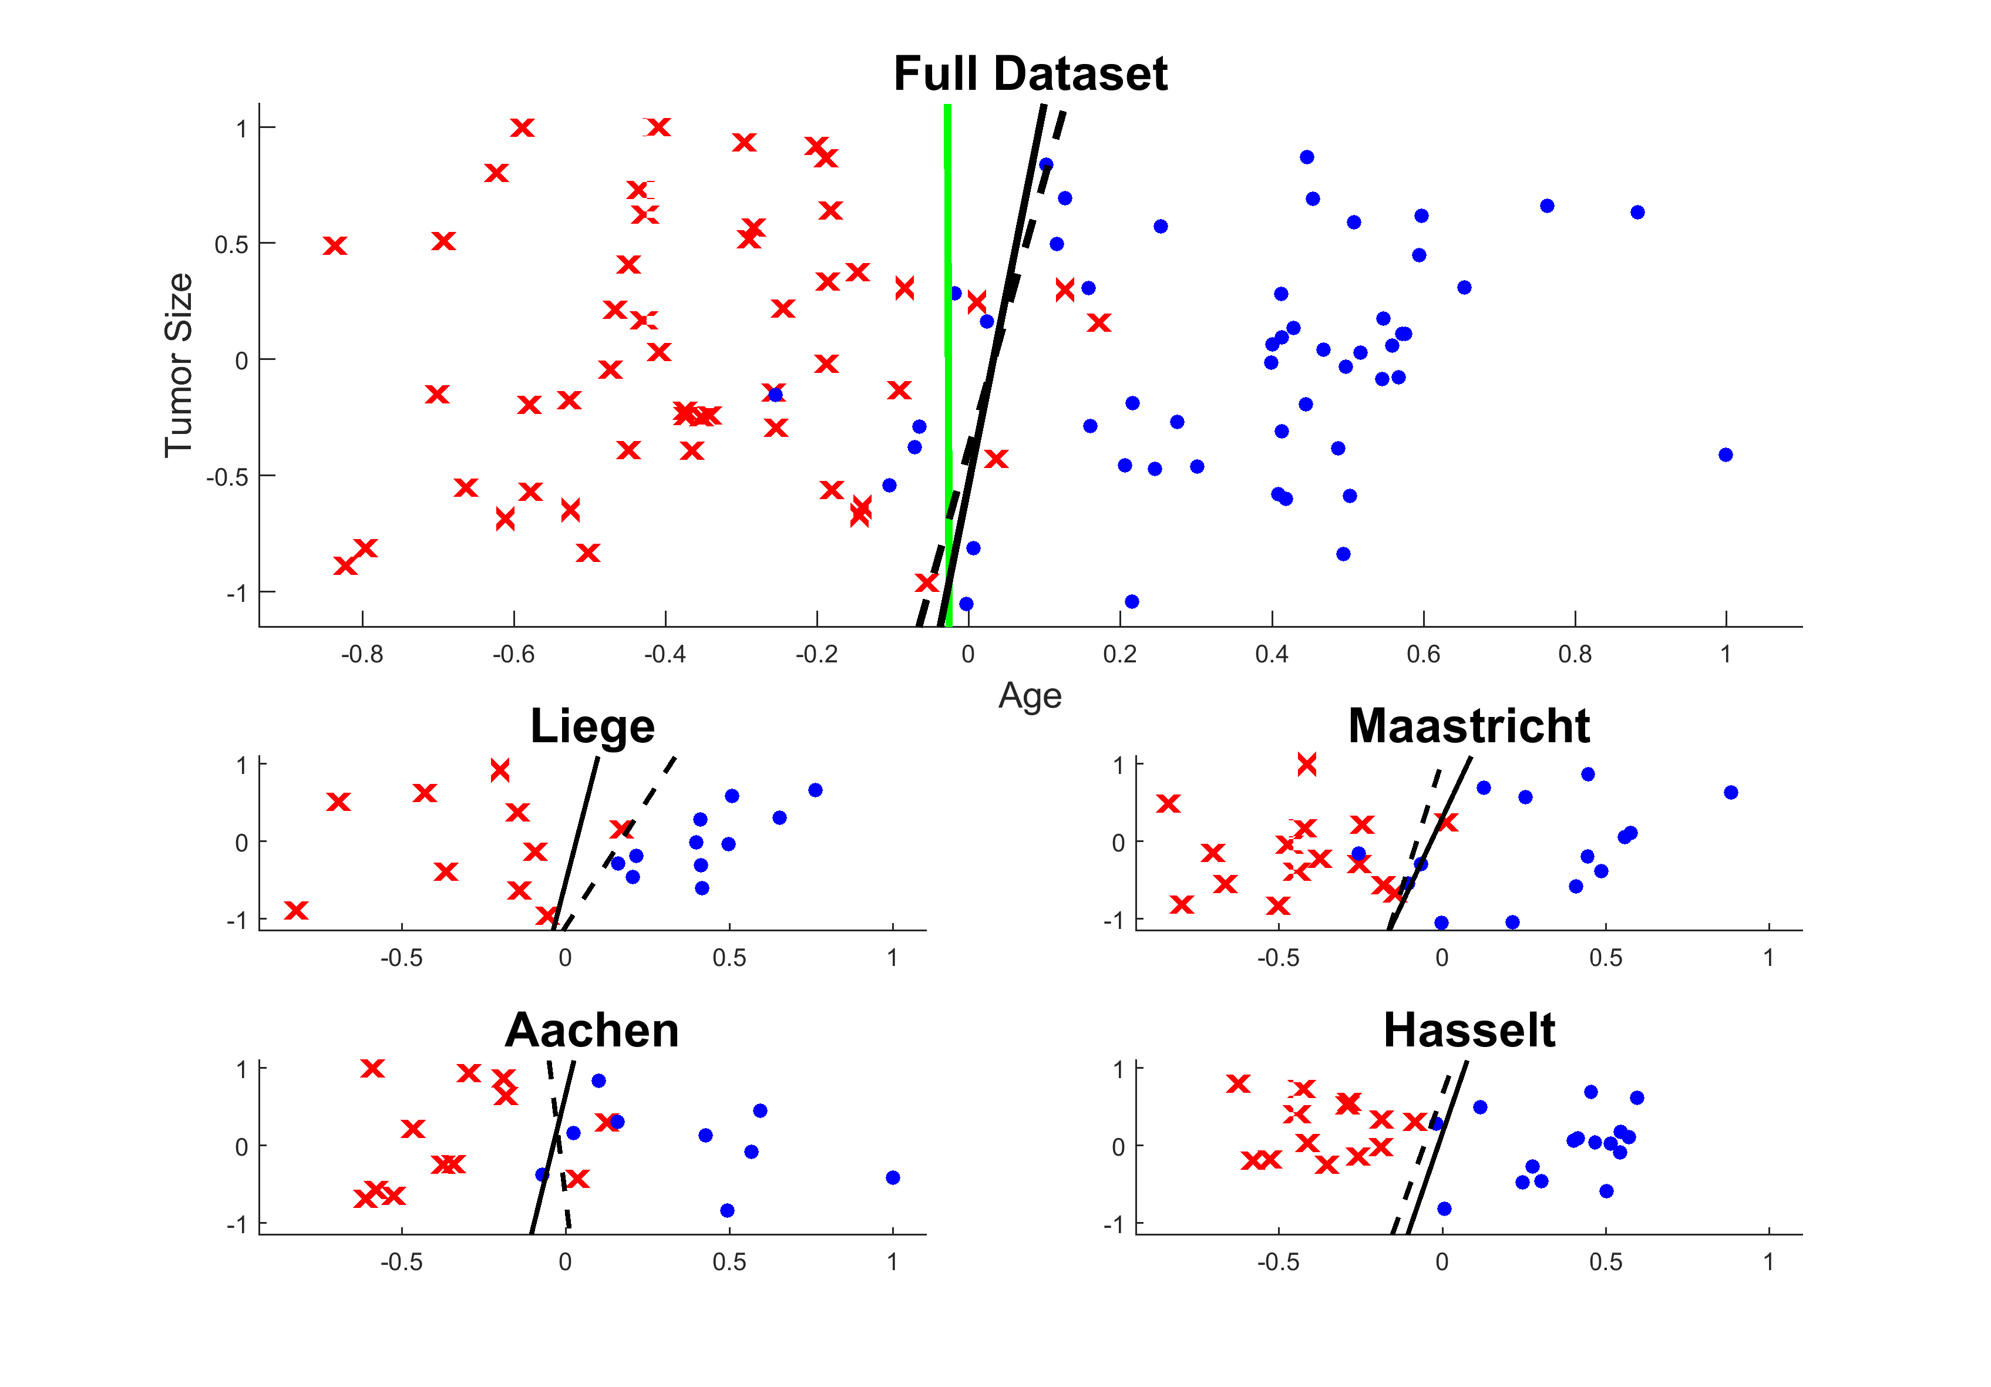
Event Patient
Non-Event Patient
Distributed Learning Solution
Centralized Learning Solution
Averaged Solution
Iteration
5

Slide 58
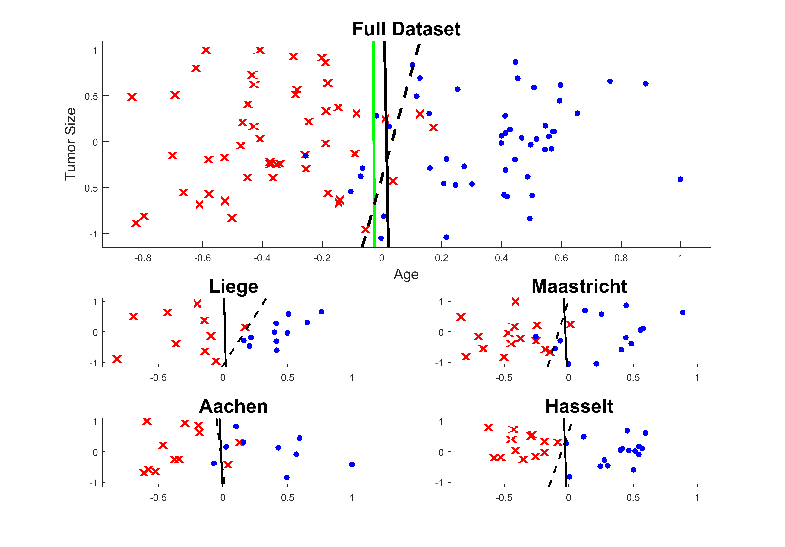
Event Patient
Non-Event Patient
Distributed Learning Solution
Centralized Learning Solution
Averaged Solution
Iteration
10

Slide 59

Event Patient
Non-Event Patient
Distributed Learning Solution
Centralized Learning Solution
Averaged Solution
Iteration
50

Slide 60
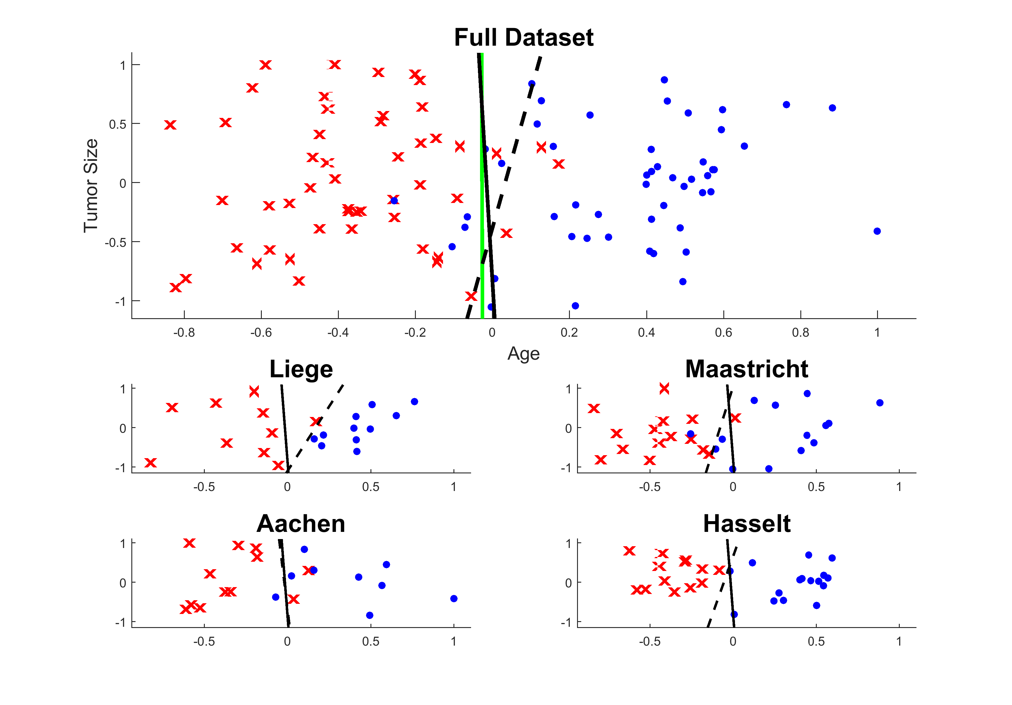
Event Patient
Non-Event Patient
Distributed Learning Solution
Centralized Learning Solution
Averaged Solution
Iteration
100

Slide 61
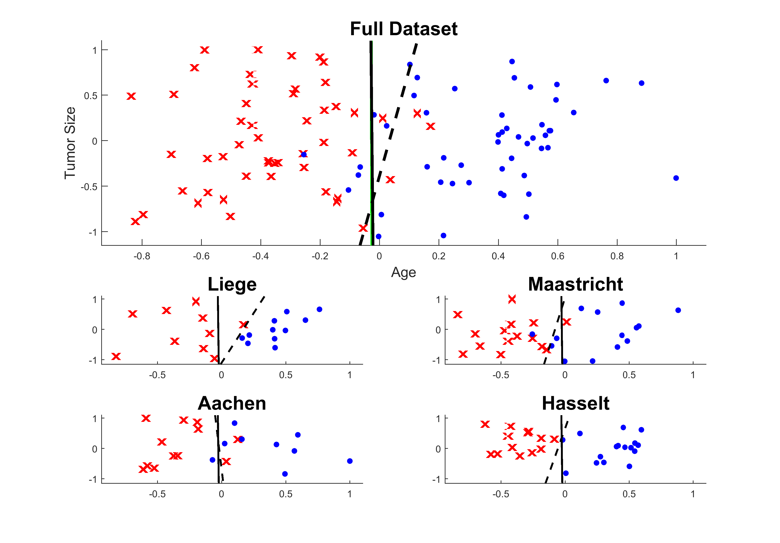
Event Patient
Non-Event Patient
Distributed Learning Solution
Centralized Learning Solution
Averaged Solution
Iteration
494

Slide 62
How?
A mathematical background
S. Boyd, Distributed Optimization and Statistical Learning via the Alternating Direction Method of Multipliers, Foundations and Trends® in Machine Learning. 3 (2010) 1–122. doi:10.1561/2200000016.
Implemented in software to use it
https://github.com/DistributedRapidLearning/DistributedSVM
Using an open-source infrastructure to execute it
https://github.com/PersonalHealthTrain/PyTaskManager

Slide 63
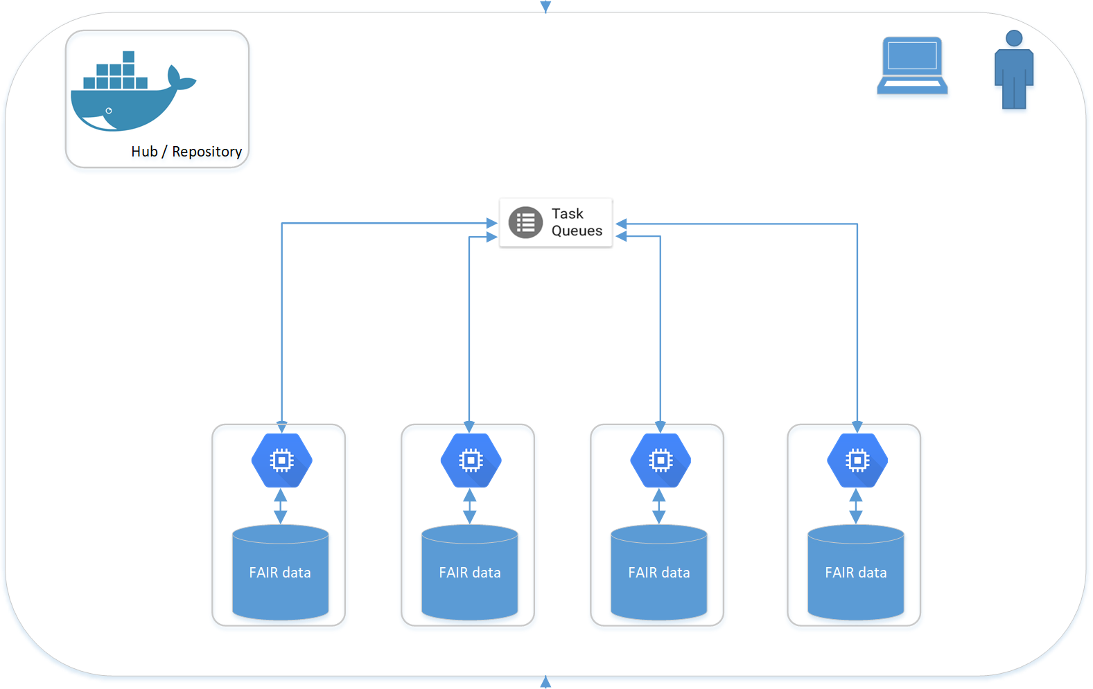
Application / IT perspective

Slide 64
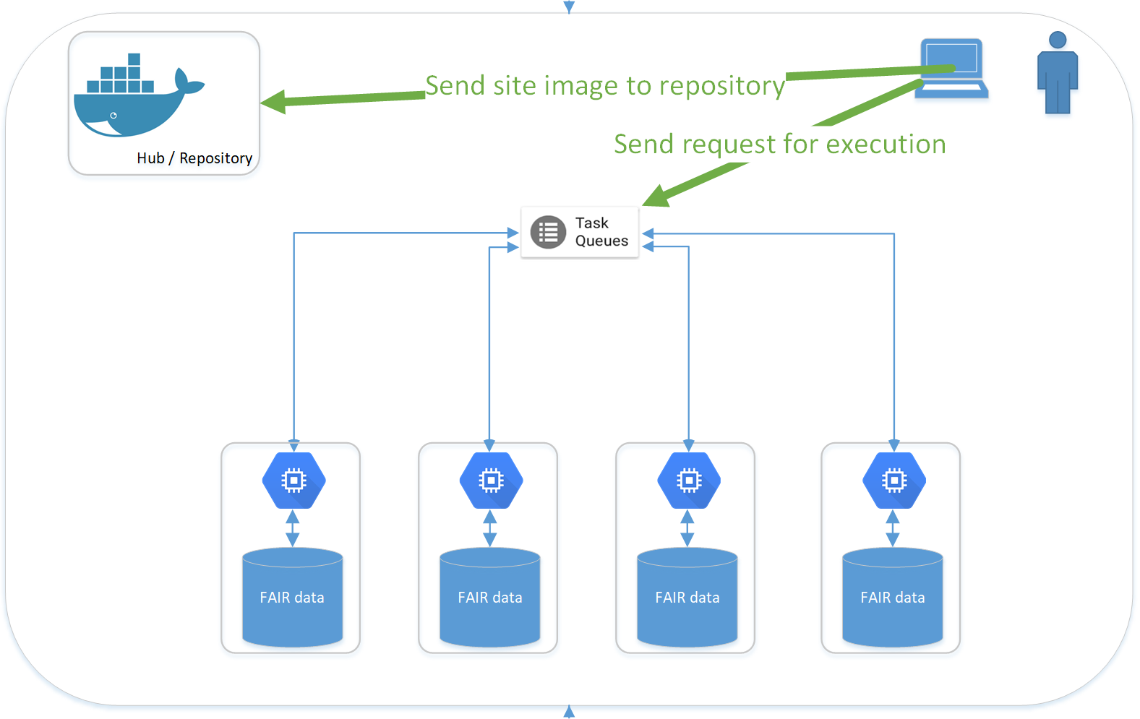
Application / IT perspective

Slide 65
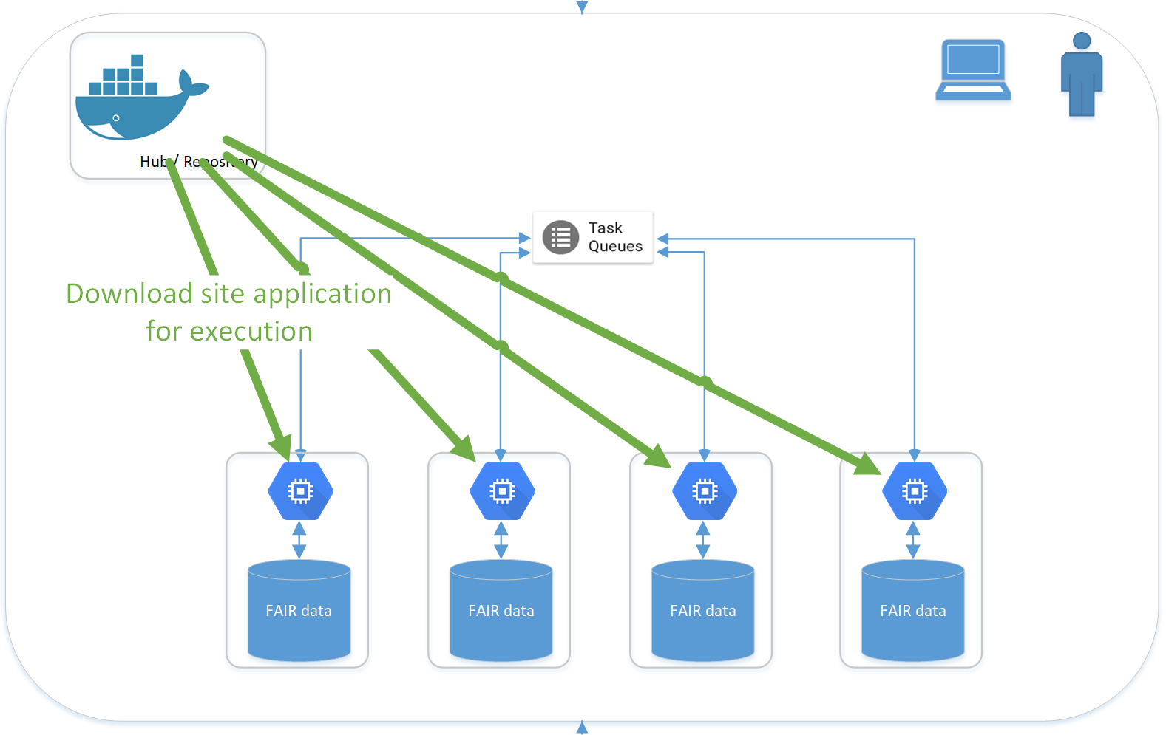
Application / IT perspective

Slide 66
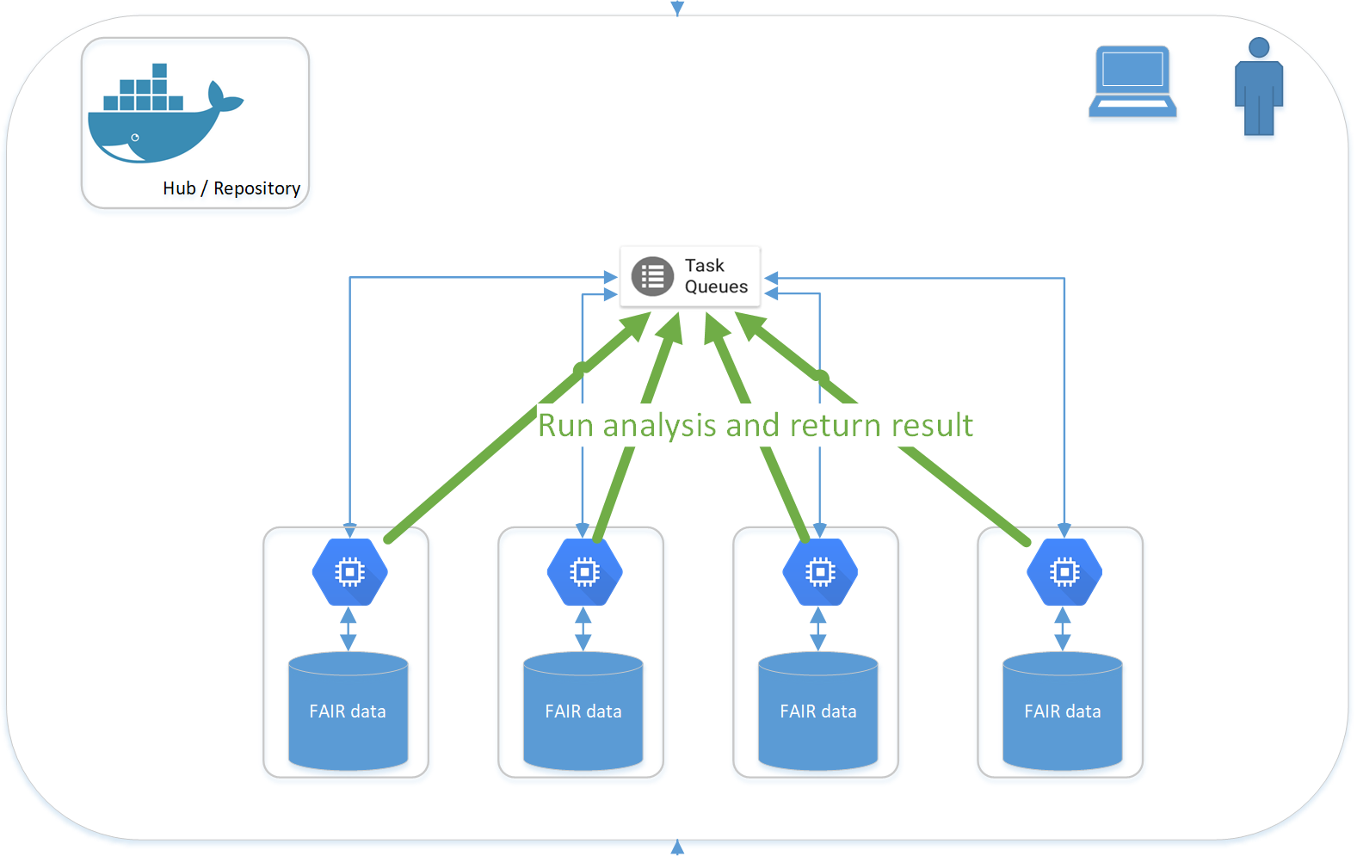
Application / IT perspective

Slide 67
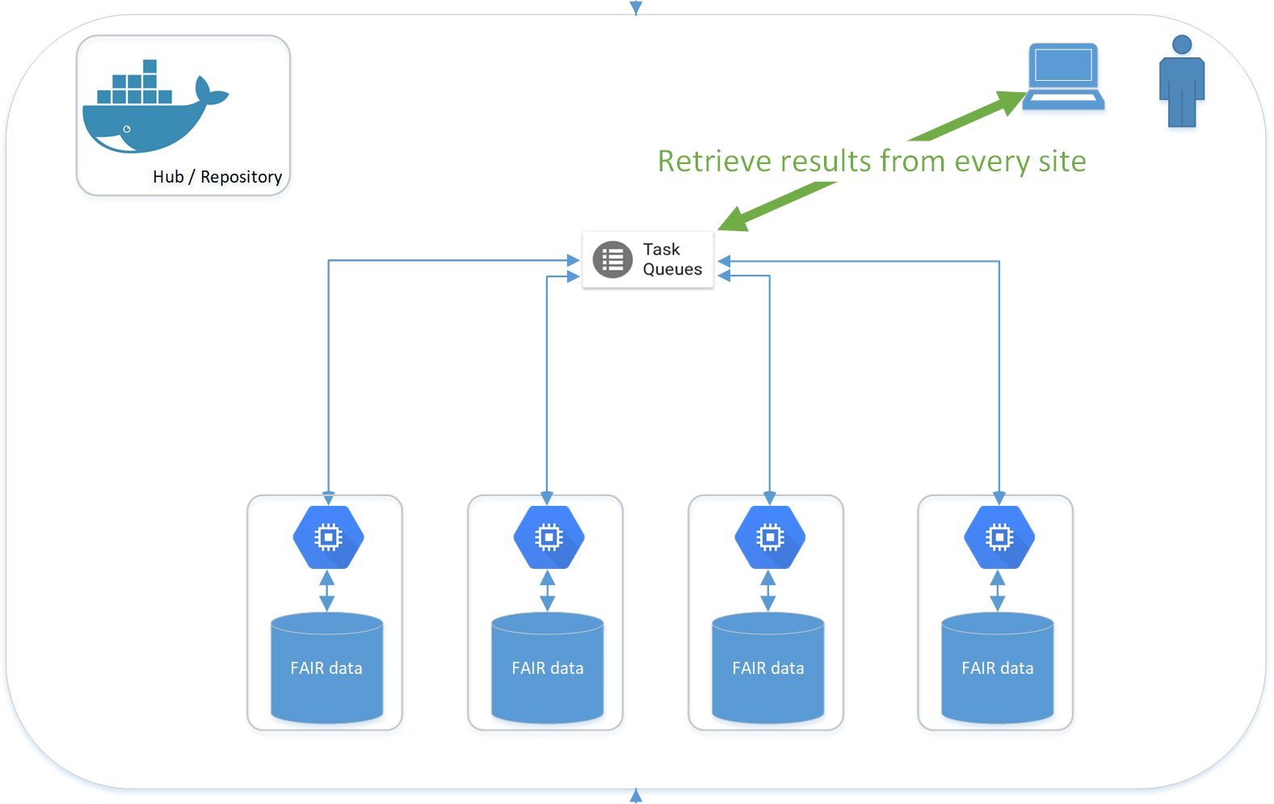
Application / IT perspective

Slide 68
Hackathon Distributed Learning
Wiki Step 5

Slide 69
Wrap-up 16:30
Johan van Soest, Andre Dekker, Zhenwei Shi
Department of Radiation Oncology (MAASTRO)
GROW - Maastricht University Medical Centre +
Maastricht, The Netherlands

Slide 70
Wrap-up Hackathon goals
Be as practical as we can!
Have fun
Extracting radiomics from real data
Mapping clinical variables to ontologies / Semantic Web
Putting Radiomics and Clinical together
Distributed analysis & learning
Final goal: Can we learn a predictive model jointly with all of you but without anyone seeing the others’ data??

Slide 71
Evaluation – comments - flag

Slide 72
Thank you for your attention
Johan van Soest
Department of Radiation Oncology (MAASTRO)
GROW - Maastricht University Medical Centre +
Maastricht, The Netherlands

Slide 73
BYOData inventory & making groups Slack channel on cds-um.slack.com

Slide 74
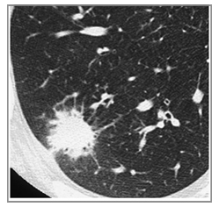

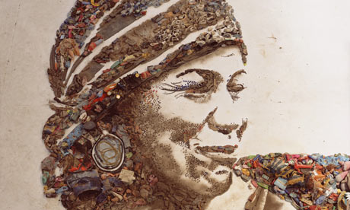
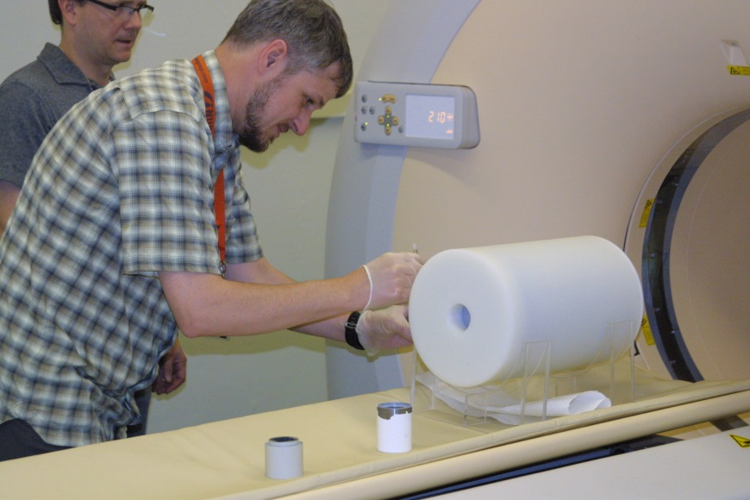
Typical Data Quality challenges
Data are unstructured
Data are not understandable
Data are missing
Data are incorrect
Data are contradicting
Data are biased
Data are biased missing
Data are implicit
Garbage in – Garbage out?
声门下区
Patient weighing 1000kg
T4N0M0 Stage IV patient
Grade 3+ toxicities
Trial arm indicates type of treatment,
Coded as “0” and “1”

Slide 75
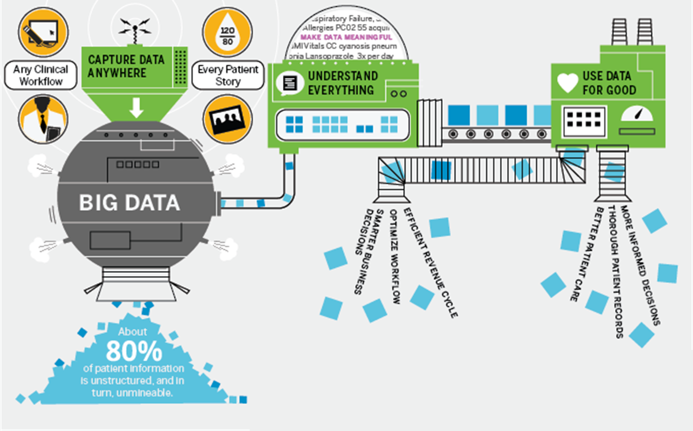
Capture, Understand, Use
nuance.com

Slide 76
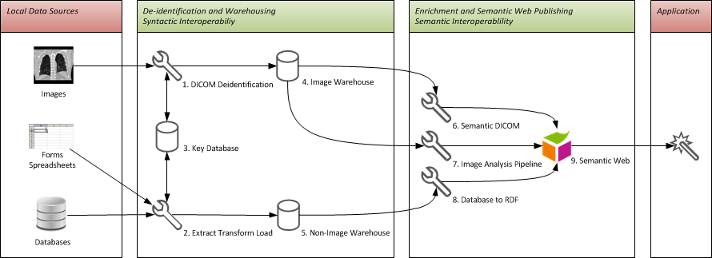
Our current workflow: primer?
https://bitbucket.org/maastroclinic/catinfrastructure_generic/wiki/high_level_infra

Slide 77
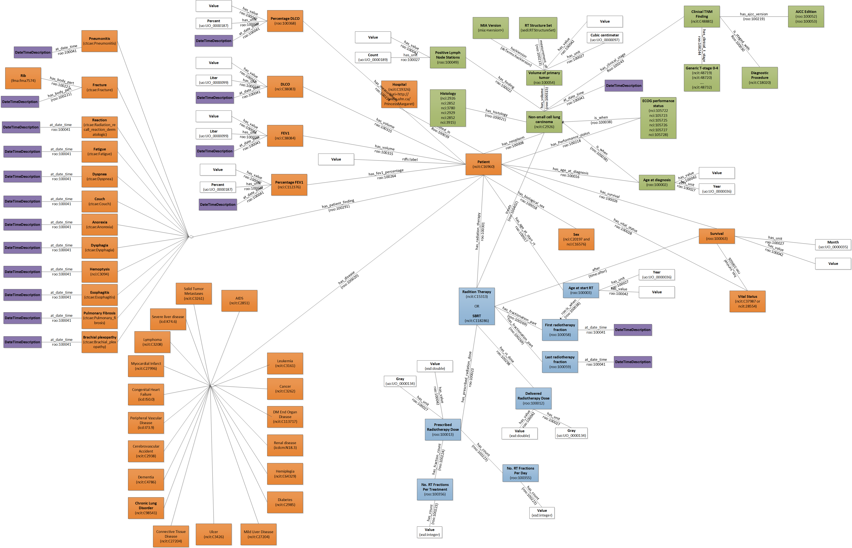

Slide 78
Primer 2.0
Separate structure and terminology conversion
https://github.com/maastroclinic/DataFAIRifier

